Slide 1
WORKSHOP ON DATA ENVELOPMENT ANALYSIS
Venue: Online
Date: 30th & 31st January 2021
Dr. Aslam Mia
School of Management, Universiti Sains Malaysia, 11800, Penang, Malaysia

Slide 2
Importance of Productivity
“Productivity isn't everything, but, in the long run, it is almost everything…..” Paul Krugman (Nobel Prize Winner in 2008).
Academic Literature
Performance Evaluation
Sustainable Development Goals (SDG’s)

Slide 3
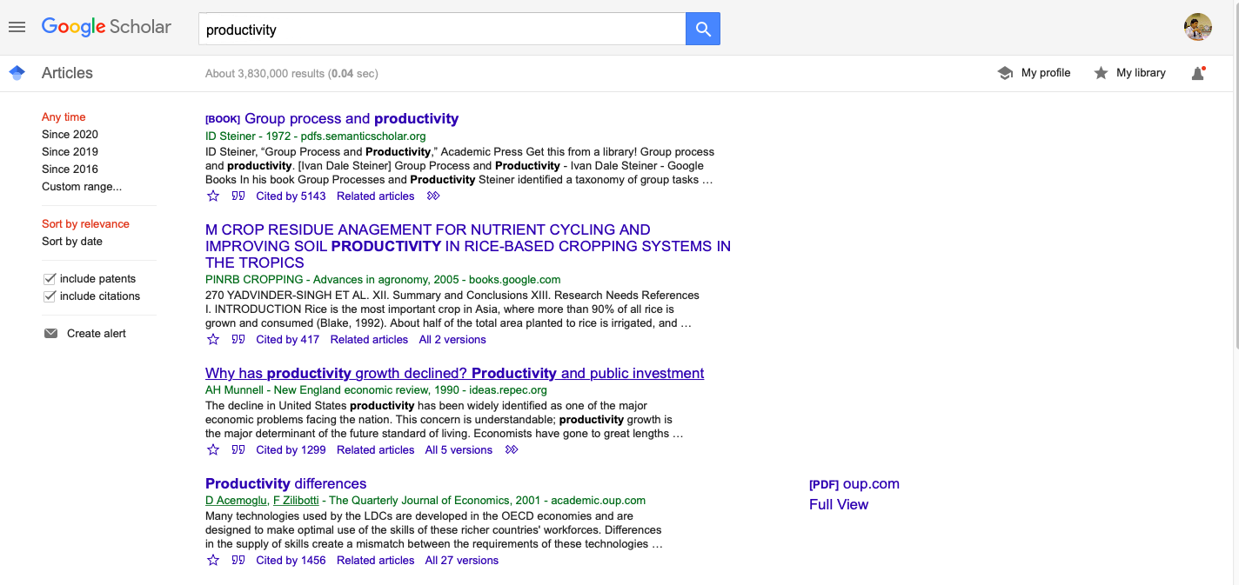
Importance of Productivity a. Academic Literature

Slide 4
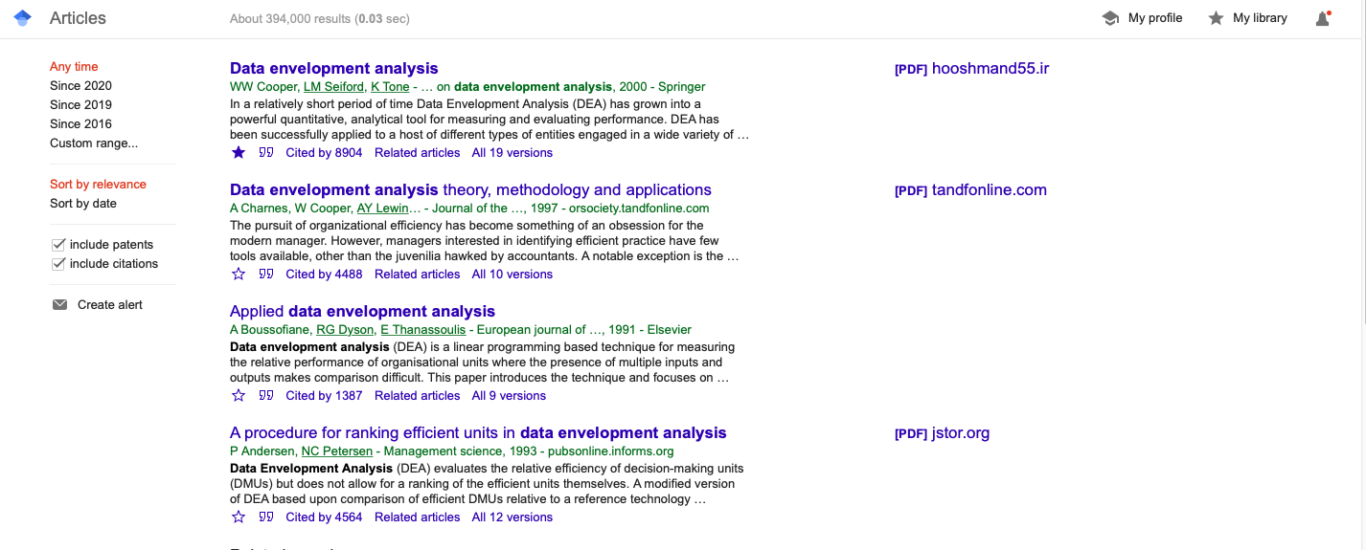
Importance of Productivity
a. Academic Literature cont.’

Slide 5
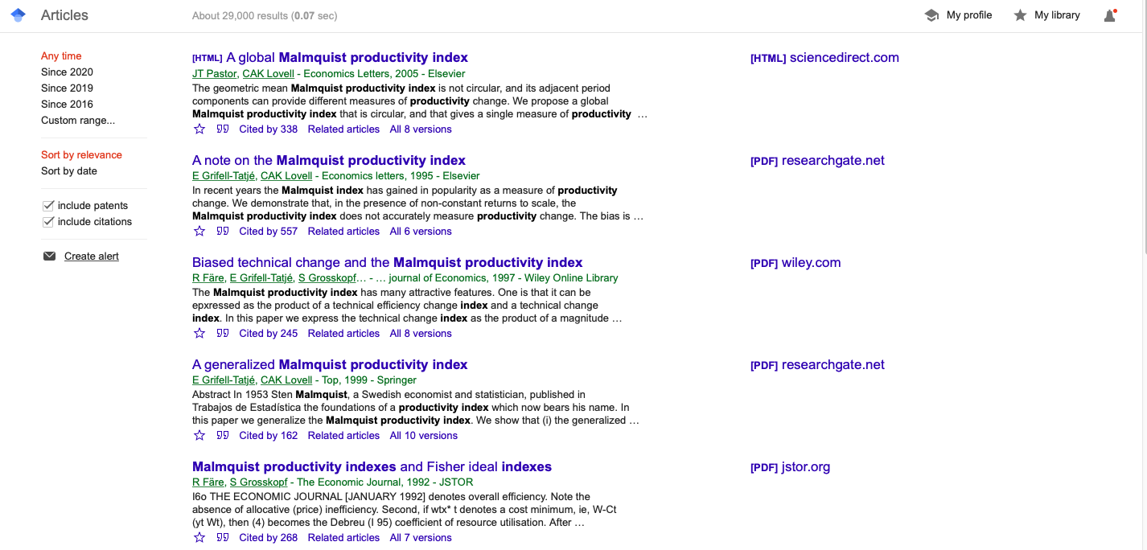
Importance of Productivity
a. Academic Literature cont.’

Slide 6

Importance of Productivity
a. Academic Literature cont.’

Slide 7

Importance of Productivity
a. Academic Literature cont.’

Slide 8
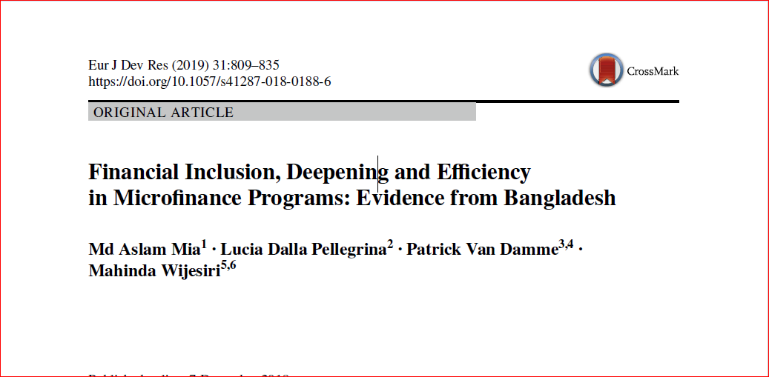
Importance of Productivity
a. Academic Literature cont.’

Slide 9
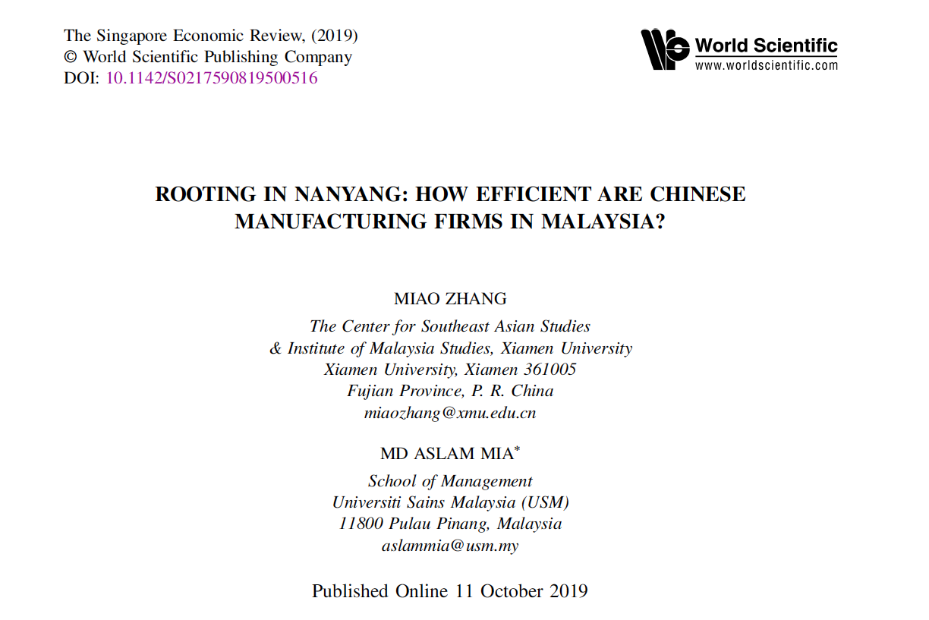
Importance of Productivity
a. Academic Literature cont.’

Slide 10

Importance of Productivity
a. Academic Literature cont.’

Slide 11

Importance of Productivity
a. Academic Literature cont.’

Slide 12

Importance of Productivity
a. Academic Literature cont.’

Slide 13

Importance of Productivity a. Academic Literature cont.’

Slide 14

Importance of Productivity
a. Academic Literature cont.’

Slide 15
Importance of Productivity b. Performance Evaluation
“Companies need to realize that gains in productivity are one of their major weapons to achieve cost and quality advantages over their competitor (Grossman 1993).”
  -self evaluation (strengths and weaknesses)
  -comparison among industry peers in one point of time or over the years
  -to choose benchmark/ top performers

Slide 16
Importance of Productivity c. Sustainable Development Goals
Profit
(Economic)
Planet
(Environment)
People
(Society)

Slide 17

Productivity

Slide 18
What is Productivity?
Productivity has different meanings to different segments (sectors)…………….(Omachonu, 1998, p.15).
“Productivity means how much and how well we produce from the resources used. If we produce more or better goods from the same resources, we increase productivity. Or if we produce the same goods from lesser resources, we also increase productivity….(Bernolak 1997,p. 204).”

Slide 19
Types of Productivity
1. Partial productivity
-often known as single productivity: one input to one
output (e.g.: labor productivity and machine productivity).
2. Total Factor Productivity
-combined productivity of all relevant inputs (basically the
combination of labor and capital).
3. Total Productivity
-ratio of output to all combined inputs including labor,
materials, capital, energy and other inputs.

Slide 20
How to Estimate Productivity?
Parametric Analysis ( e.g.: Stochastic Frontier Analysis)
Non-parametric Analysis (e.g.: Data Envelopment Analysis)
We will use DEA developed by Charnes, Cooper, and Rhodes (1978) to evaluate productivity of microfinance Institutions (MFIs).

Slide 21
Why Data Envelopment Analysis?
Charnes, Cooper, and Rhodes (1978), assert that DEA is suitable for non-governmental entities.
It can handle multiple inputs and outputs at the same time.
It does not require any prior functional form.
Flexibility with the choice of measurements of input and output.
  DEA is a unit invariance and has no influence on the estimated efficiency or productivity.
To compare the performance of various Decision Making Units (DMUs) at a single point in time or over a period of time.

Slide 22
Why Data Envelopment Analysis Cont.?
DEA uses simple concept of the production process – a single black box where the inputs are transformed into outputs.
The results are easy to understand and interpret.
The most unique feature of DEA is that the indices can be decomposed.

Slide 23
Why Data Envelopment Analysis Cont.’?
Input
Output
TFP/MPI
Pure Technical
Efficiency Change (PTE)
Technological Change (TC)
Technical Efficiency Change (TEC)
Scale Efficiency (SE)

Slide 24
Selection of Input and Output
One of the challenges in estimating productivity is determining appropriate input and output.
Selection of input and output should be based on the objective/classification of the firms/industry.
Most of the cases, MFIs productivity/efficiency are estimated by combining two input and three output.

Slide 25
Sample Size
No specific ‘rule of thumb’ to determine the optimal sample size in DEA analysis
If number of DMUs decreases (or the numbers of inputs and outputs increases), the discrimination power and accuracy of DEA with respect to the performance of DMUs decreases.
Two arguments behind choosing the sample size in DEA
  larger sample sizes allow estimations to capture high performance units, which will generate a more reliable and efficient frontier, as well as substantially improve the discriminatory power of the data.
  a large sample size may decrease homogeneity and increase the influence of exogenous variables or other factors that impact the overall results

Slide 26
Sample Size Cont.’
Using a moderate sample size is relatively better in DEA.
Number of DMU should be a multiple of inputs and outputs.
Twice the number of inputs and outputs.
Total of two times the product of inputs and outputs.
Three times the total inputs and outputs.
“Bear in mind that the sample size should be representative of the sector we are evaluating”

Slide 27
Reference
A good reference for determining size of DMU’s, number of input and output, missing values, non-negative value and so on.
Sarkis, J. (2007). Preparing your data for DEA. In Modeling data irregularities and structural complexities in data envelopment analysis (pp. 305-320). Springer, Boston, MA.

Slide 28
Software
DEAP 2.1 Computer Program developed by Tim Coelli (1996) will be used to estimate Malmquist Productivity
Download the software from the following link;
https://economics.uq.edu.au/cepa/software
For preliminary data analysis and efficiency, we will use STATA software.
Efficiency can be estimated by DEAP 2.1 computer program as well. To estimate Malmquist productivity by STATA, it needs latest version of the software.

Slide 29
Data Requirement
Minimum two years of data.
Balanced panel dataset.
No zero or negative values for input or output.

Slide 30

Efficiency

Slide 31
Efficiency Analysis
Estimating efficiency is relatively easier
The sample size can vary over time
Efficiency has to be estimated yearly than in aggregately (not like productivity)
Same software (Deap 2.1) can be used to estimate efficiency as well

Slide 32
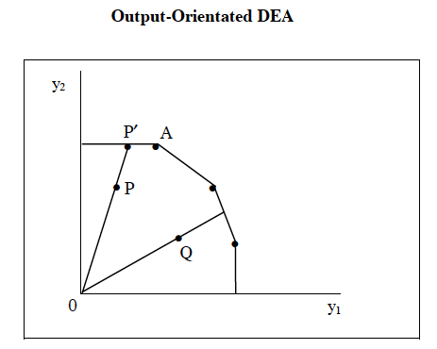

Slide 33
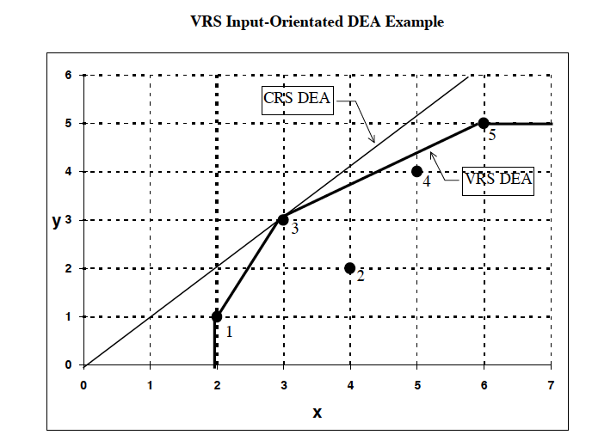

Slide 34
Remarks for efficiency
The output and input oriented models will estimate exactly the same frontier and therefore identify the same set of DMU’s as being efficient.
It is only the efficiency measures associated with the inefficient DMU’s that may differ between the two methods.

Slide 35
Constant Vs Variable return to scale
Returns to scale- is a concept in economics to describe the rise in output as a result of an increase in inputs. This is particularly useful when seeking efficient production or maximizing profits by lowering production costs.
When an increase in inputs (capital and labour) cause the same proportional increase in output. Constant returns to scale occur when increasing the number of inputs leads to an equivalent increase in the output.
Variable returns to scale (VRS) is a type of frontier scale used in data envelopment analysis (DEA). It helps to estimate efficiencies whether an increase or decrease in input or outputs does not result in a proportional change in the outputs or inputs respectively

Slide 36
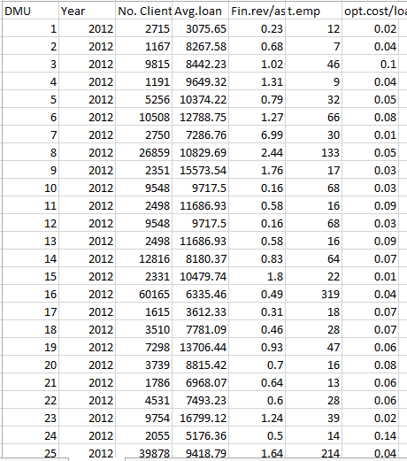
Data Arrangement

Slide 37
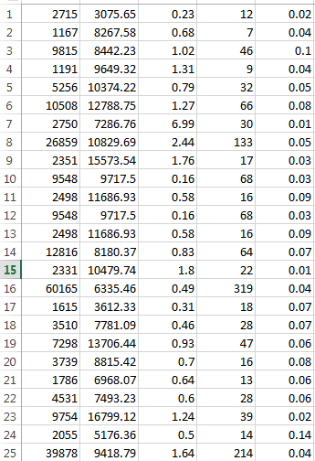
Data Arrangement Cont.’
(for software use)

Slide 38
Thank You
If you have any concern or queries, please drop an email to
aslammia@usm.my

Slide 39
Useful references
To understand and execute DEAP 2.1, read the pdf file in the zip file by T. Coelli.
To understand various efficiency result for deap 2.1: https://www.projectguru.in/projected-values-vrs-dea/
For preparing data(input/output), read this; Sarkis, J. (2007). Preparing your data for DEA. In J. Jhu & W. D. Cook (Eds.), Modeling data irregularities and structural complexities in data envelopment analysis (pp. 305–320). US: Springer.

Slide 40
txt problem in your computer, kindly go through this website and follow the procedures.
https://www.bleepingcomputer.com/tutorials/how-to-show-file-extensions-in-windows/

