Slide 1
Predictive modelling

Slide 2
Objectives of the course
concepts of predictive modelling.
Different types of predictive modelling.

Slide 3
Data TYPEs
Categorical data represents categories, classes and classifications, groups, or qualitative characteristics or attributes.
respondent gender (male or female)
product disposition (conforming or nonconforming)
patient mortality (survived or died)
Continuous data represents measurements.
length, time, temperature, concentration
Categorical data is qualitative, continuous data is quantitative.
Categorical data values are discrete and the distance between categories is unknown.

Slide 4
Correlation
A Correlation exists between two variables if the distribution of one variable changes when the level (or value) of the other variable changes.
If there is no Correlation, the distribution of the first variable is the same, regardless of the level of the other variable.
Example: Whether and FOOD choice.

Slide 5
Linear regression
Given an input x we would like to compute an output y
For example:
- Predict height from age
- Predict Google’s price from Yahoo’s price
- Predict distance from wall from sensors
Y
X

Slide 6
Linear regression
Given an input x we would like to compute an output y
In linear regression we assume that y and x are related with the following equation:
y = wx+ε
where w is a parameter and ε represents measurement or other noise
Y
Observed values
What we are trying to predict
X

Slide 7
Nomenclature of predictive modelling
The input variables are Predictors and out put variables is called Response.
Regression:
Logit(i)
Logit(2)= a₂+BX
Equal Slopes
Logit(1)= a₁+BX
Predictor X

Slide 8
Linear Regression Prediction Formula
^
^
^
^
y
= w₀ + w₁ x₁ + w₂ x₂
prediction
estimate
·
·
intercept
estimate
parameter
estimate
Choose intercept and parameter estimates to minimize:
squared error function
^
∑( y_{i} – y_{i} )²
training
data

Slide 9
Linear regression
Y
Our goal is to estimate w from a training data of <x_{i},y_{i}> pairs
Optimization goal: minimize squared error (least squares):
Why least squares?
- minimizes squared distance between measurements and predicted line
- has a nice probabilistic interpretation
- the math is pretty
X
see HW

Slide 10
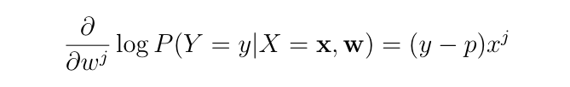
Solving linear regression
To optimize:
We just take the derivative w.r.t. to w ….
prediction
prediction
Compare to logistic regression…

Slide 11
Solving linear regression
To optimize – closed form:
We just take the derivative w.r.t. to w and set to 0:
covar(X,Y)/var(X)
if mean(X)=mean(Y)=0

Slide 12
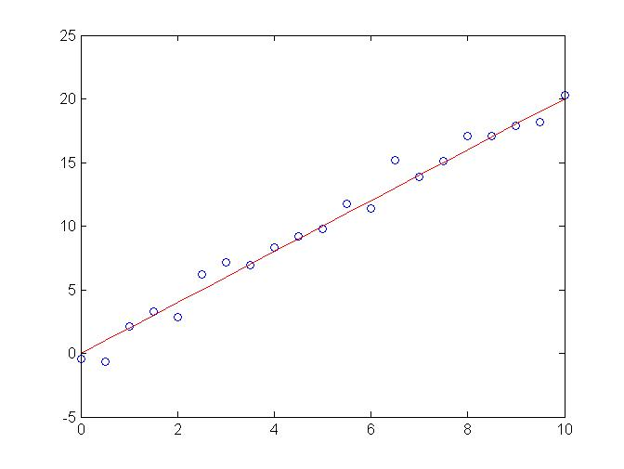
Regression example
Generated: w=2
Recovered: w=2.03
Noise: std=1

Slide 13
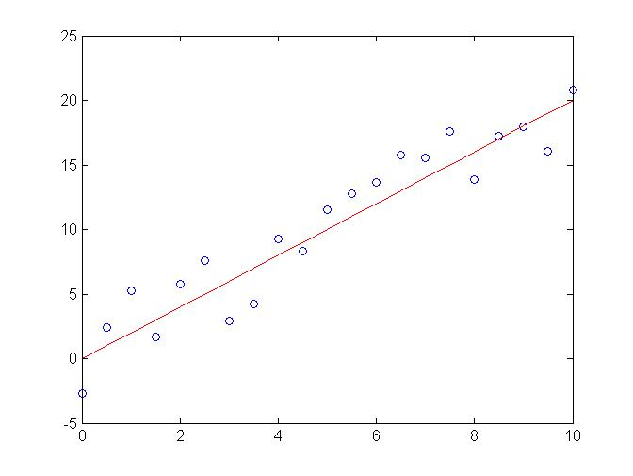
Regression example
Generated: w=2
Recovered: w=2.05
Noise: std=2

Slide 14
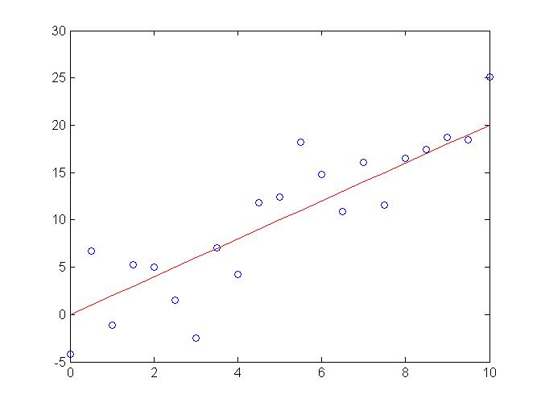
Regression example
Generated: w=2
Recovered: w=2.08
Noise: std=4

Slide 15
Bias term
So far we assumed that the line passes through the origin
What if the line does not?
No problem, simply change the model to
y = w₀ + w₁x+ε
Can use least squares to determine w₀ , w₁
Y
w₀
X

Slide 16
Bias term
Simpler solution is coming soon…
So far we assumed that the line passes through the origin
What if the line does not?
No problem, simply extend the model to
y = w₀ + w₁x+ε
Can use least squares to determine w₀ , w₁
Y
w₀
X

Slide 17
Multivariate regression
What if we have several inputs?
- Stock prices for Yahoo, Microsoft and Ebay for the Google prediction task
This becomes a multivariate regression problem
Again, its easy to model:
y = w₀ + w₁x₁+ … + w_{k}x_{k} + ε
Google’s stock price
Microsoft’s stock price
Yahoo’s stock price

Slide 18
Multivariate regression
What if we have several inputs?
- Stock prices for Yahoo, Microsoft and Ebay for the Google prediction task
This becomes a multivariate regression problem
Again, its easy to model:
y = w₀ + w₁x₁+ … + w_{k}x_{k} + ε

Slide 19
y=10+3x₁²-2x₂²+ε
Not all functions can be approximated by a line/hyperplane…
In some cases we would like to use polynomial or other terms based on the input data, are these still linear regression problems?
Yes. As long as the coefficients are linear the equation is still a linear regression problem!
Notes:
Add function and best linear approximation

Slide 20
Non-Linear basis function
So far we only used the observed values x₁,x₂,…
However, linear regression can be applied in the same way to functions of these values
Eg: to add a term w x₁x₂ add a new variable z=x₁x₂ so each example becomes: x₁, x₂, …. z
As long as these functions can be directly computed from the observed values the parameters are still linear in the data and the problem remains a multi-variate linear regression problem

Slide 21
Non-linear basis functions
What type of functions can we use?
A few common examples:
- Polynomial: φ_{j}(x) = x^{j} for j=0 … n
- Gaussian:
- Sigmoid:
- Logs:
Any function of the input values can be used. The solution for the parameters of the regression remains the same.

Slide 22
General linear regression problem
Using our new notations for the basis function linear regression can be written as
Where φ_{j}(x) can be either x_{j} for multivariate regression or one of the non-linear basis functions we defined
… and φ₀(x)=1 for the intercept term

Slide 23


Logistic Regression Prediction Formula
p
1 – p
(
^
)
^
^
^
= w₀ + w₁ x₁ + w₂ x₂
·
·
logit scores
log
^
What is Machine Learning?
^
1.0
p
1 – p
(
)
0.9
log
^
^
^
= w₀ + w₁ x₁ + w₂ x₂
^
·
0.8
0.70
0.7
0.6
x₂
0.5
0.60
0.4
0.3
0.50
0.2
0.1
0.40
0.0
0.0
0.1
0.2
0.3
0.4
0.5
0.6
0.7
0.8
0.9
1.0
x₁

Slide 24
What is Machine Learning?
The subfield of computer science that “gives computers the ability to learn
without being explicitly programmed”.
A computer program is said to learn from experience E with respect to some class of tasks T and performance measure P if its performance at tasks in T, as measured by P, improves with experience E.”
Using data for answering questions Training Predicting

Slide 25
Types of Learning
Supervised (inductive) learning
Training data includes desired outputs
Unsupervised learning
Training data does not include desired outputs
Semi-supervised learning
Training data includes a few desired outputs
Reinforcement learning
Rewards from sequence of actions

Slide 26
Machine Learning Based Predictive modeling
ANN (Artificial Neural Network)
ML (Machine Learning)
DL (Deep Learning)

Slide 27
Definition of Gaussian Process Regression (GPR)
A Gaussian process is defined as a probability distribution over functions y(x), such that the set of values of y(x) evaluated at an arbitrary set of points x1,.. Xn jointly have a Gaussian distribution.
Probability distribution indexed by an arbitrary set
Any finite subset of indices defines a multivariate Gaussian distribution
Input space X, for each x the distribution is a Gaussian, what determines the GP is
The mean function µ(x) = E(y(x))
The covariance function (kernel) k(x,x')=E(y(x)y(x'))
In most applications, we take µ(x)=0. Hence the prior is represented by the kernel.

Slide 28
Linear regression updated by GPR
Specific case of a Gaussian Process
It is defined by the linear regression model
with a weight prior
the kernel function is given by

Slide 29
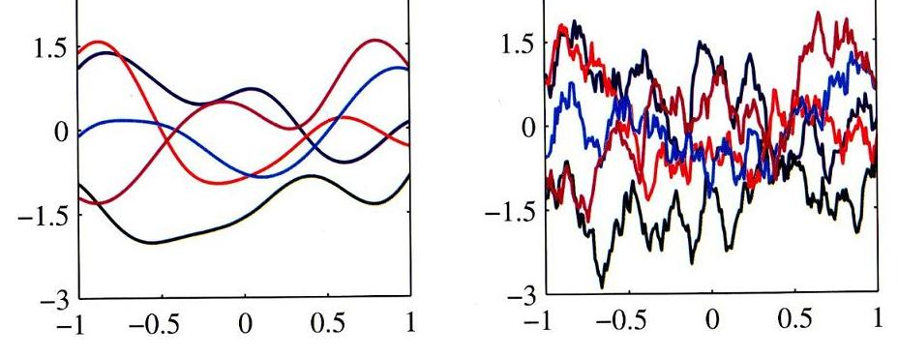
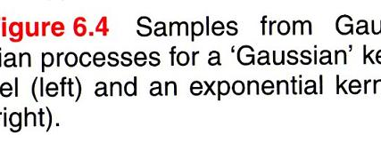
Kernel function
We can also define the kernel function directly.
The figure show samples of functions drawn from Gaussian processes for two different choices of kernel functions

Slide 30
GP for Regression
Take account of the noise on the observed target values,
which are given by

Slide 31
GP for regression
From the definition of GP, the marginal distribution p(y) is given by
The marginal distribution of t is given by
Where the covariance matrix C has elements

Slide 32
GP for Regression
We’ve used GP to build a model of the joint distribution over sets of data points
Goal:
To find , we begin by writing down the joint distribution

Slide 33
GP for Regression
The conditional distribution is a Gaussian distribution with mean and covariance given by
These are the key results that define Gaussian process regression.
The predictive distribution is a Gaussian whose mean and variance both depend on

Slide 34
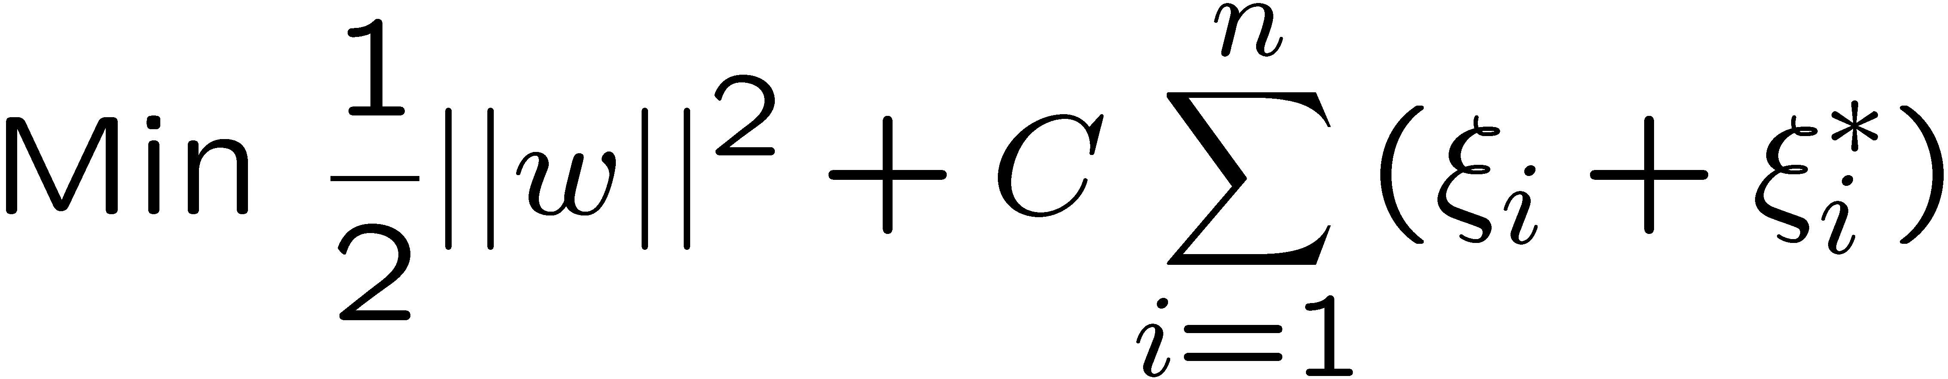
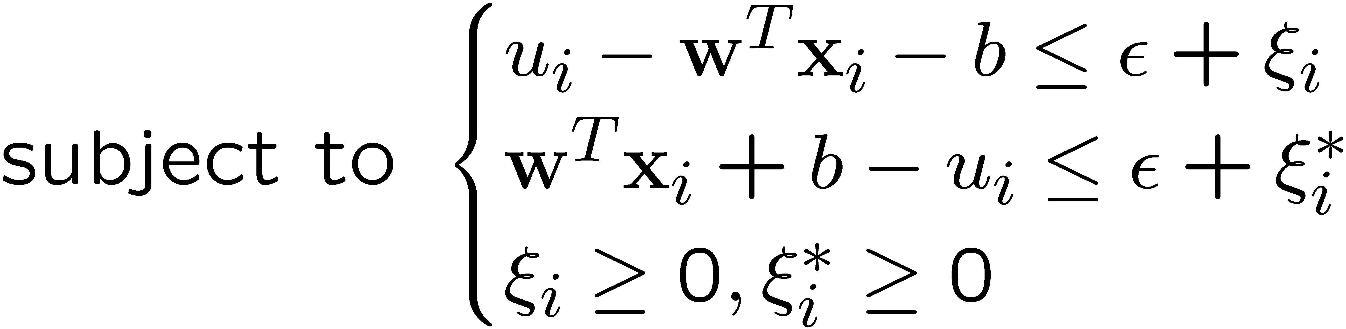
Epsilon Support Vector Regression (ε-SVR)
Given: a data set {x₁, ..., x_{n}} with target values {u₁, ..., u_{n}}, we want to do ε-SVR
The optimization problem is
Similar to SVM, this can be solved as a quadratic programming problem

Slide 35
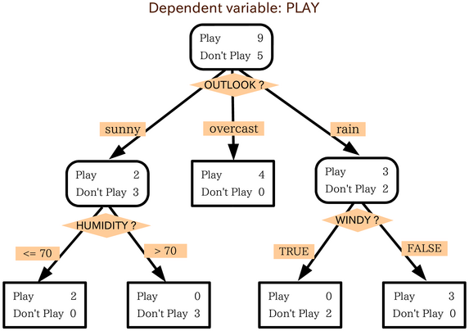
A decision tree: classification
Play
Don’t Play
Don’t Play
Play

Slide 36

Introduction
Artificial Neural Networks (ANN)
Information processing paradigm inspired by biological nervous systems
ANN is composed of a system of neurons connected by synapses
ANN learn by example
Adjust synaptic connections between neurons

Slide 37
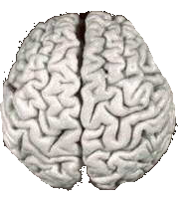

Comparison of Brains and Traditional Computers
200 billion neurons, 32 trillion synapses
Element size: 10⁻⁶ m
Energy use: 25W
Processing speed: 100 Hz
Parallel, Distributed
Fault Tolerant
Learns: Yes
Intelligent/Conscious: Usually
1 billion bytes RAM but trillions of bytes on disk
Element size: 10⁻⁹ m
Energy watt: 30-90W (CPU)
Processing speed: 10⁹ Hz
Serial, Centralized
Generally not Fault Tolerant
Learns: Some
Intelligent/Conscious: Generally No

Slide 38
Biological Inspiration
Idea : To make the computer more robust, intelligent, and learn, …
Let’s model our computer software (and/or hardware) after the brain
“My brain: It's my second favorite organ.”
- Woody Allen, from the movie Sleeper

Slide 39
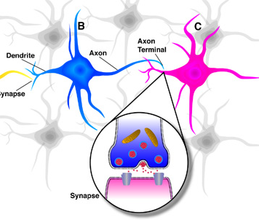
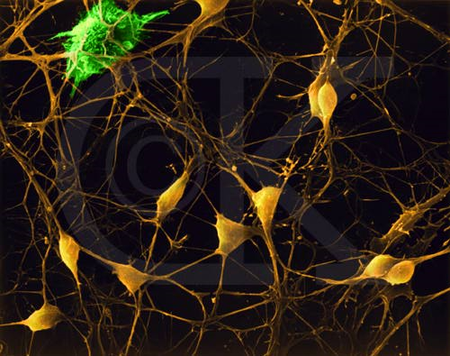
Neurons in the Brain
Although heterogeneous, at a low level the brain is composed of neurons
A neuron receives input from other neurons (generally thousands) from its synapses
Inputs are approximately summed
When the input exceeds a threshold the neuron sends an electrical spike that travels that travels from the body, down the axon, to the next neuron(s)

Slide 40

Learning in the Brain
Brains learn
Altering strength between neurons
Creating/deleting connections
Hebb’s Postulate (Hebbian Learning)
When an axon of cell A is near enough to excite a cell B and repeatedly or persistently takes part in firing it, some growth process or metabolic change takes place in one or both cells such that A's efficiency, as one of the cells firing B, is increased.
Long Term Potentiation (LTP)
Cellular basis for learning and memory
LTP is the long-lasting strengthening of the connection between two nerve cells in response to stimulation
Discovered in many regions of the cortex

Slide 41
Perceptrons
Initial proposal of connectionist networks
Rosenblatt, 50’s and 60’s
Essentially a linear discriminant composed of nodes, weights
I1
W1
I1
W1
or
W2
W2
O
I2
O
I2
W3
W3
I3
Activation Function
I3
1

Slide 42
Multi-layer Networks and Perceptrons
- Have one or more layers of hidden units.
- With two possibly very large hidden layers, it is possible to implement any function.
- Networks without hidden layer are called perceptrons.
- Perceptrons are very limited in what they can represent, but this makes their learning problem much simpler.

Slide 43
Activation Function
To apply the LMS learning rule, also known as the delta rule, we need a differentiable activation function.
Old:
New:

Slide 44
Network Structures
Feed-forward neural nets:
Links can only go in one direction.
Recurrent neural nets:
Links can go anywhere and form arbitrary
topologies.

Slide 45
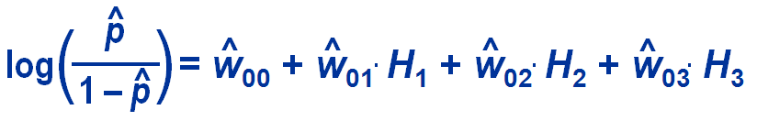
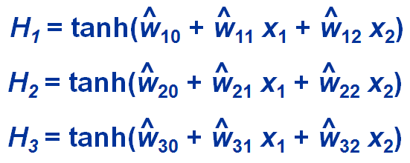
ANN Architecture
H₁
x₁
H₂
y
x₂
H₃
input
layer
hidden
layer
target
layer

Slide 46

Feed-forward Networks
Arranged in layers.
Each unit is linked only in the unit in next layer.
No units are linked between the same layer, back to
the previous layer or skipping a layer.
-Computations can proceed uniformly from input to
output units.
- No internal state exists.

Slide 47
Feed-Forward Example
H3
H5
I1
W₃₅ = 1
W₁₃ = -1
t = -0.5
t = 1.5
I1
W₅₇ = 1
W₂₅ = 1
O7
t = 0.5
W₁₆ = 1
I2
W₆₇ = 1
W₂₄= -1
t = -0.5
t = 1.5
W₄₆ = 1
H4
H6
Inputs skip the layer in this case

Slide 48

Recurrent Network
The brain is not and cannot be a feed-forward network.
Allows activation to be fed back to the previous unit.
Internal state is stored in its activation level.
Can become unstable
Can oscillate.

Slide 49
May take long time to compute a stable output.
Learning process is much more difficult.
Can implement more complex designs.
Can model certain systems with internal states.
Recurrent Network

Slide 50

Thank you

